Slide 1
Industry Day 2016 – Sensors, IoT and Drones!
Rooms | Time | Topic | Presenter
Industry Day Overview Sensors Applications for IoT Room: Bonaire 5-6 | 11:00 – 11:10 | IEEE Sensors Council Welcome | A. Dehennis
 | 11:10 – 11:30 | IoT Standards Initiatives | Sri Chandra
 | 11:30 – 12:00 | IoT, Sensors and Smart Living of the Future | Teresa Pace, UCF
 | 12:00 – 12:30 | Sensors and Connectivity | Clay Hine, Nordic Semiconductor
Caribbean I-III | 12:30 – 1:30 | Lunch Industry Panel UAV Regulations and Opportunities | Panel
Sensor Applications and IoT Initiatives Room: Bonaire 5-6 | 1:30 – 2:00 | Sensors for FirstNET and First Responders | Allan Sadowski, NC FirstNet
 | 2:00 – 2:30 | Sensor Based Information Innovation: Satellites, UAVs, and IoT Platforms | R. Spangler, PlazaBridge Group
 | 2:30 – 3:00 | RIoT and 2017 Initiatives | T. Snyder, RIoT, L. Steffann, WRCNC
 | 3:00 – 3:30 | Coffee Break
Industry Resources and IEEE SENSORS Council Industry Initiatives Room: Bonaire 5-6 | 3:30 – 400 | IEEE SC Standards: IoT Harmonization | William Miller, MaCT USA
 | 4:00 – 4:30 | Modeling a Complete RFID Sensor System | Markus Kopp, ANSYS
 | 4:30 – 5:00 | IEEE Sensors Council Industry Initiatives | G. Hayes
Boca Patio | 5:30 – 7:00 | Industry Day Social – Sponsored by ANSYS, and RIoT

Slide 2
IEEE Sensors 2015 Industrial Panel
Unmanned Arial Vehicles (UAV’s):
Drones
Session Goal: To facilitate a discussion between Industry and Academia about the Technologies, Opportunities and the Regulatory Barriers of Unmanned Arial Vehicles and Systems
Panelists
Tom Snyder, RiOT (Moderator)
Scott Bland, Nordic Semi
Larry Steffann, Wireless Research Center of NC
Allan Sadowski, NC FirstNet
Teresa Pace, ICAMR
Richard Spangler, PlazaBridge Group
Session Co-Chairs
Andrew DeHennis, Senseonics
Gerry Hayes, Wireless Research Center of NC

Slide 3
The Session Overview
Panelist Opening Statements (5min each)
Planned Discussion and Questions
Questions from the Floor
Closing Statements

Slide 4

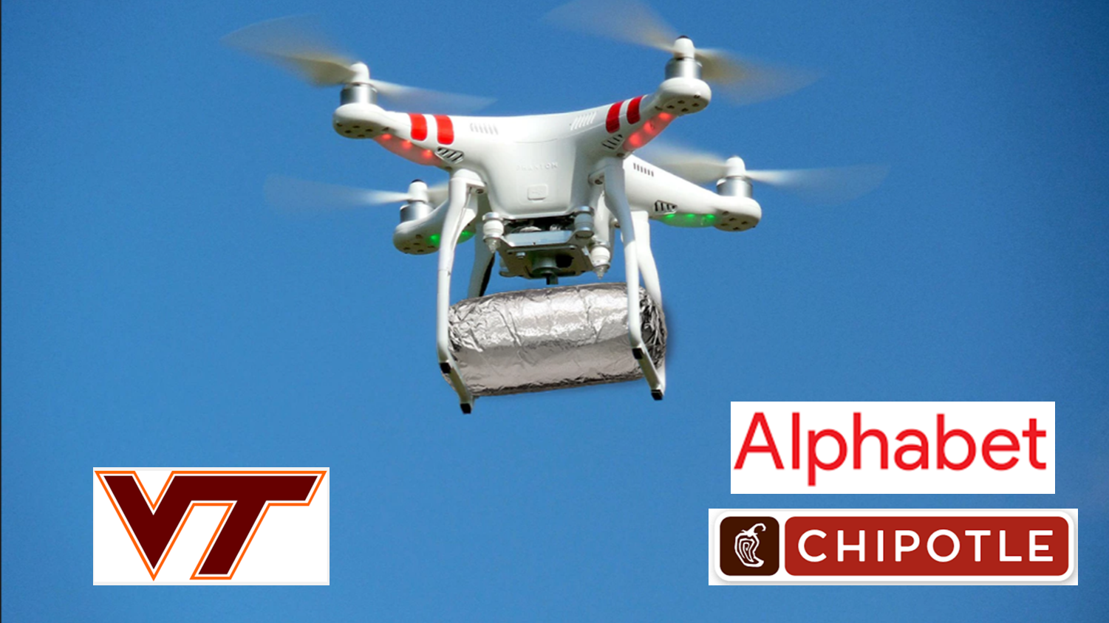
Moderator: Tom Snyder,
Executive Director
Company: NCRIoT

Slide 5
The Panelists

Slide 6
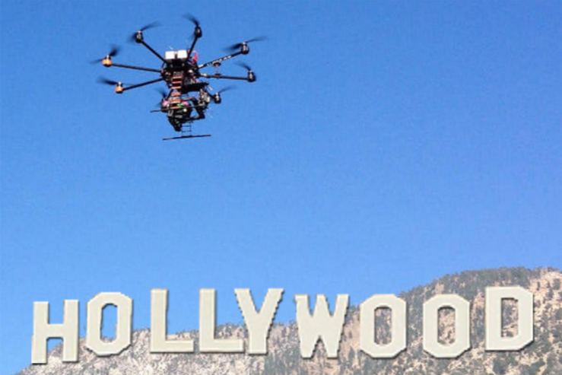
Panelist: Scott Bland
FAE / Drone Pilot
Company: Nordic Semi

Slide 7
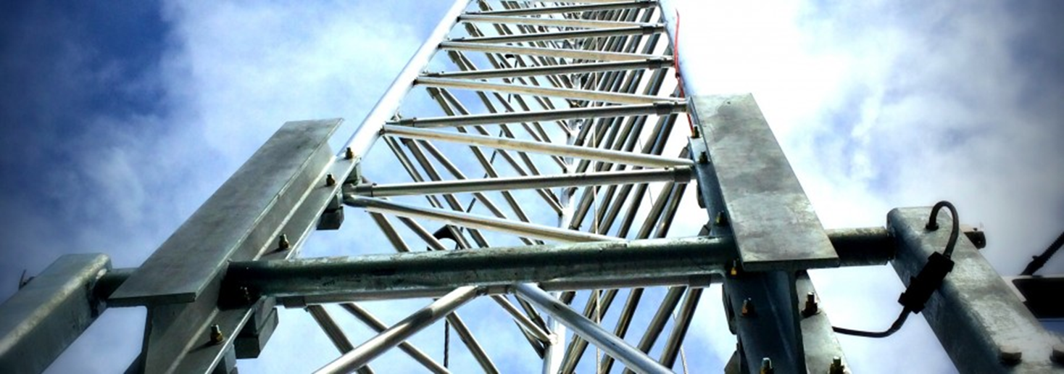
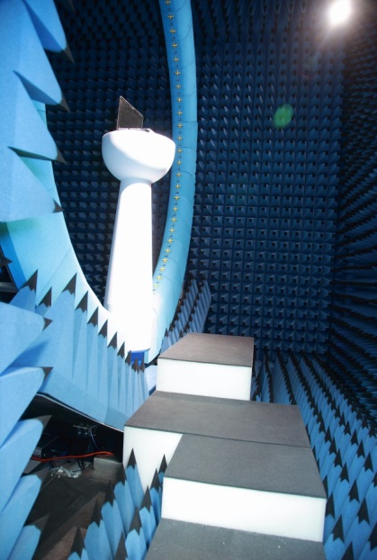

Panelist: Larry Steffann, WRCNC
Company: Wireless Research Center of North Carolina
GM of the Wireless Research Center of North Carolina, Co-Founder of RIoT, Co-Founder of Gaming incubator Joystick Labs and serial entrepreneur. Lead RIot’s team effort in the Global Cities Team Challenge, ILPS Intelligent Led Public Safety) effort with NIST. Mr. Steffann has been CEO of Amex Company, nStor (NSO) and COO of a NASDAQ company, Boca Research (BOCI)
A Non Profit 501(C)(3) Wireless Research HUB

Slide 8

Panelist: Allan Sadowski
Director of Infrastructure Planning
Broadband Infrastructure Office
Company: NC FirstNet
Important aspects of FirstNet
“GREENFIELD” UHF spectrum - Standards based - LTE R13
Nationwide coverage for public safety (by law, rural and urban)
Public Safety grade of service (power, secondary backhaul)
Priority for Public Safety use but secondary users needed (IoT?)

Slide 9
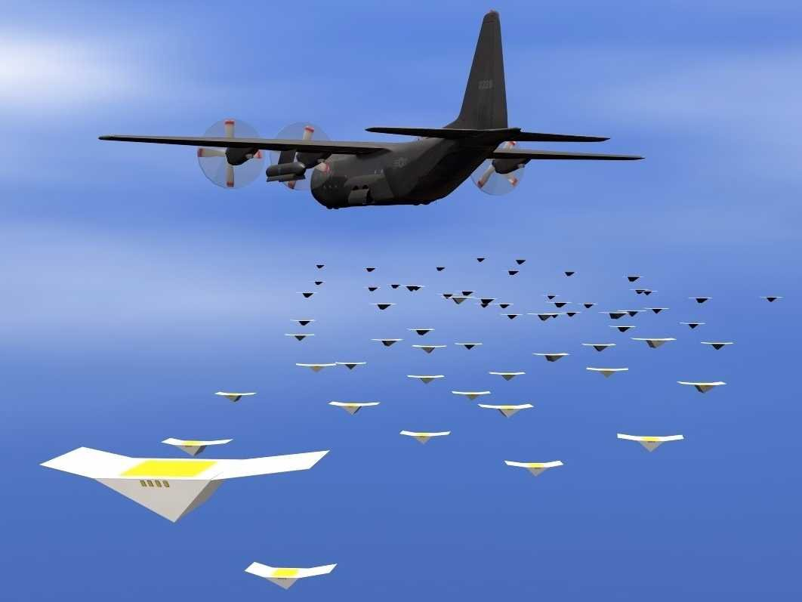
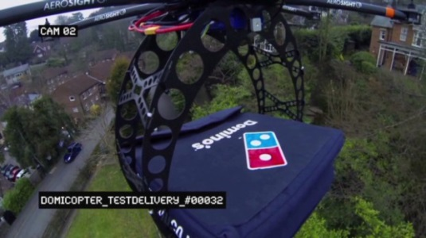
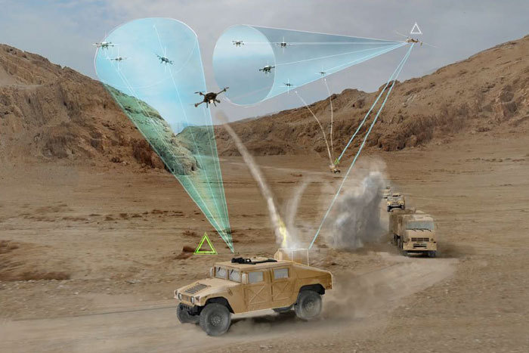
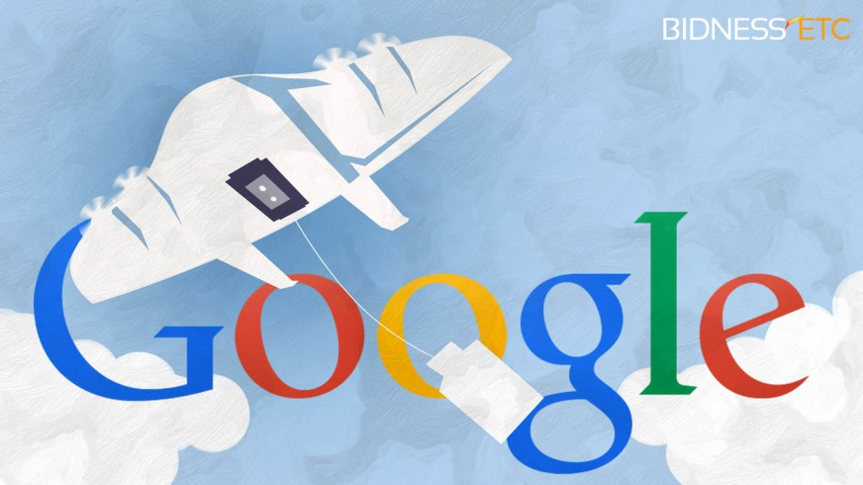
Panelist: Teresa Pace,
Director of State and Federal Programs
Company: ICAMR

Slide 10


Panelist: Richard Spangler
Company: PlazaBridge Group

Slide 11
The Panel Questions

Slide 12
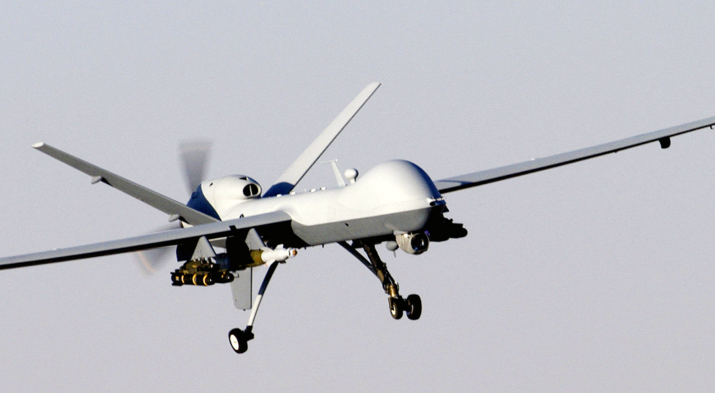
Drones are proliferating across many industries. Agriculture, military, building inspection, film-making, racing, food delivery.
What industries are driving technology requirements the hardest?

Slide 13
Drones and Their Sensors …
How are drones interacting through sensor data with the environment around them?
What are the important sensor outputs aside from the obvious use of accelerometers/gyros to keep drones aloft?
Are these sensors more typically deployed on the drone, or on infrastructure communicating to the drone?

Slide 14
How did this all start ….
What key technical achievement has launched (pun intended) this drone excitement?
Who from the sensor research sector should we be thanking?

Slide 15
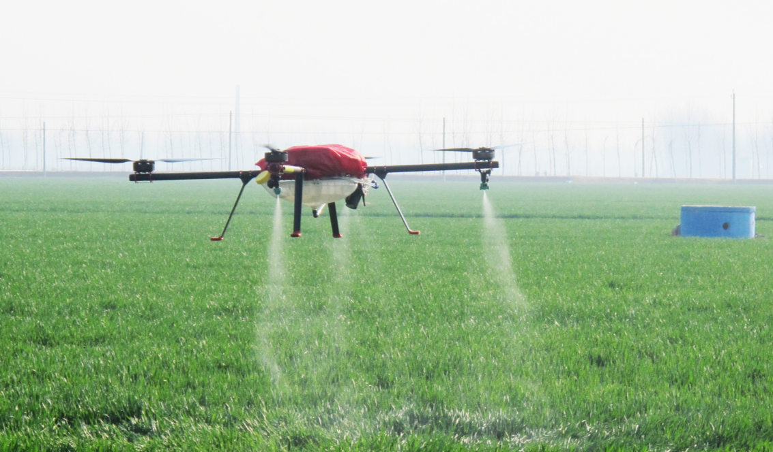
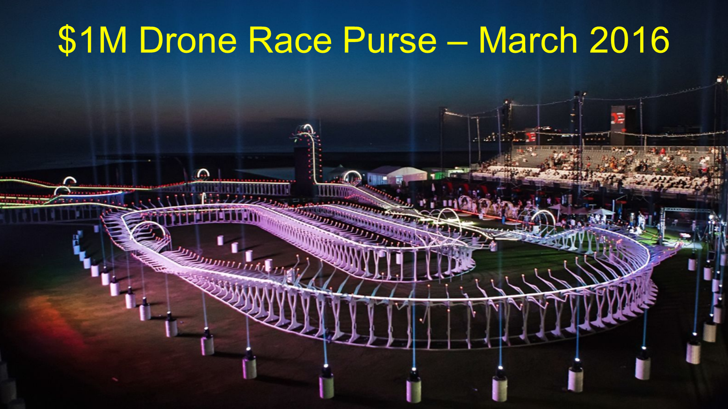
What wireless protocols are in play in the UAV space?
- Frequency?
- Encryption?
- Overall Connectivity?

Slide 16
The Open Questions
Audience ???

